Slide 1
Design change and Added pages

Slide 2
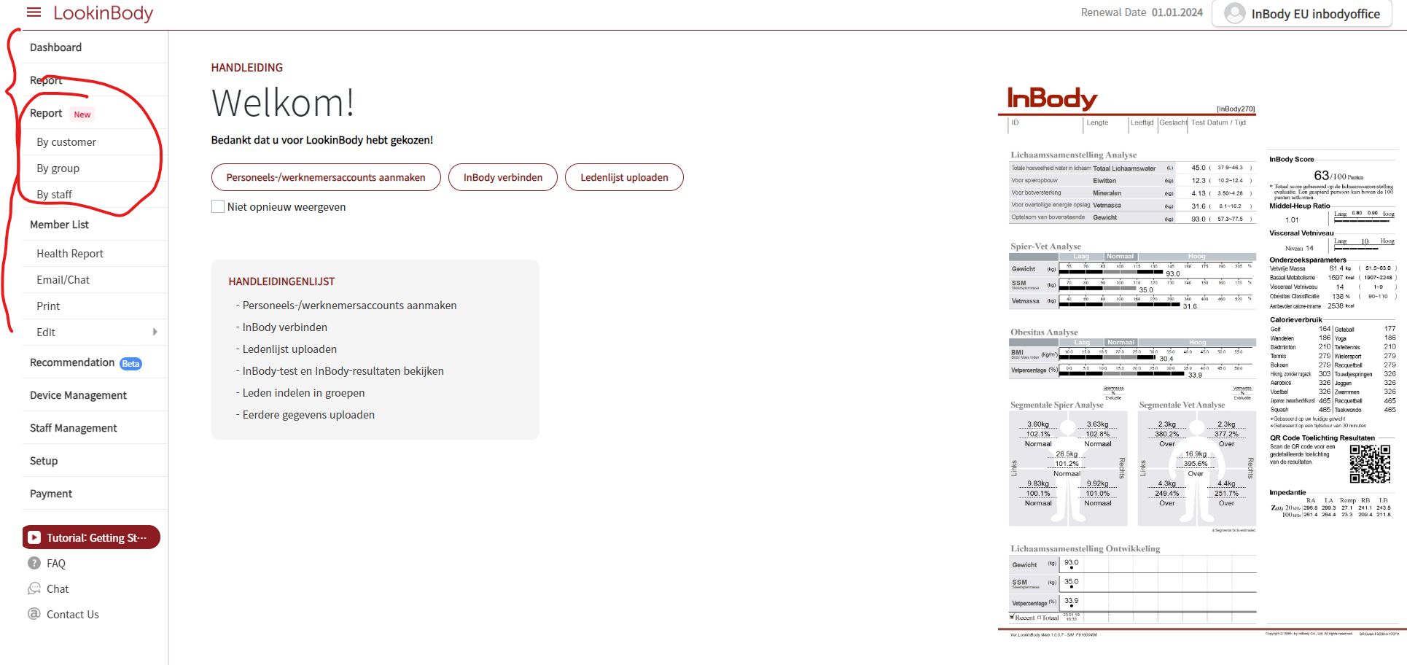
New report page.
Old one would be deleted later

Slide 3
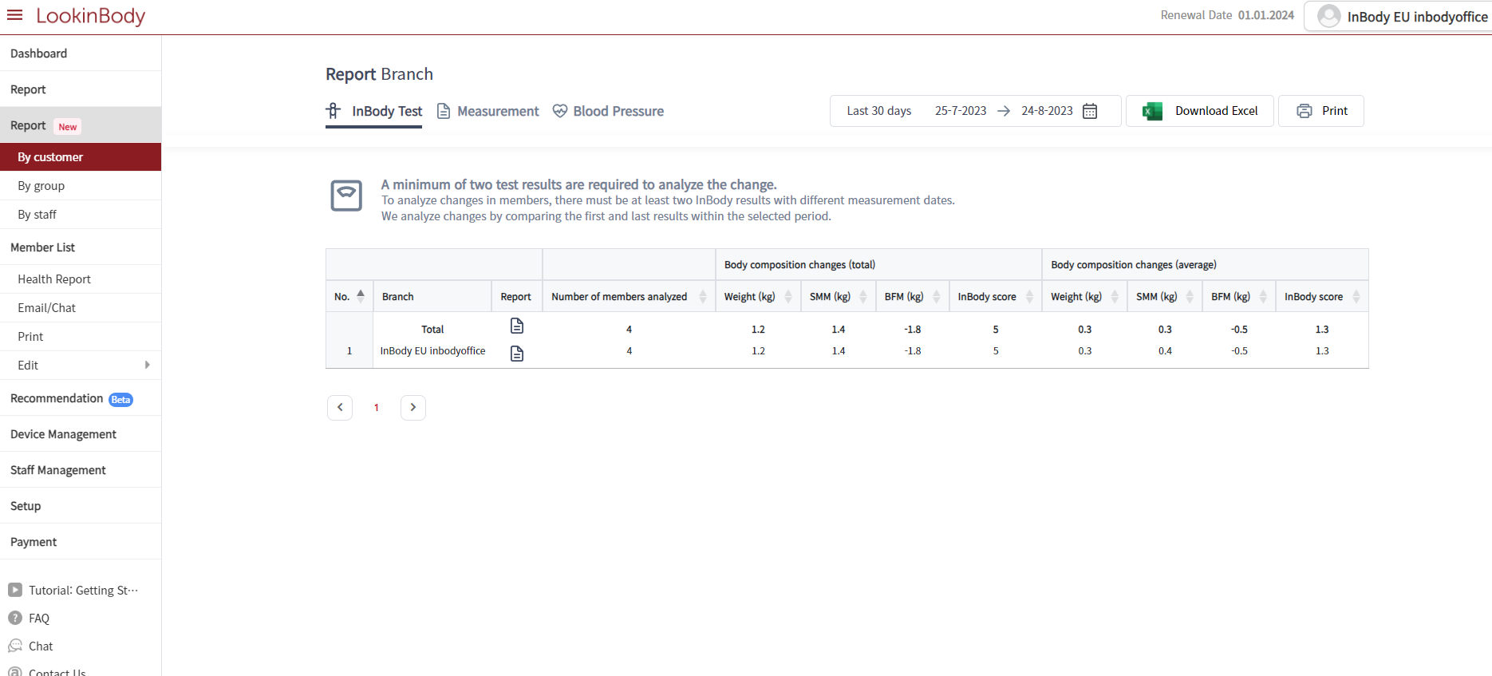
Report grouped by customer, group, staff are provided.

Slide 4
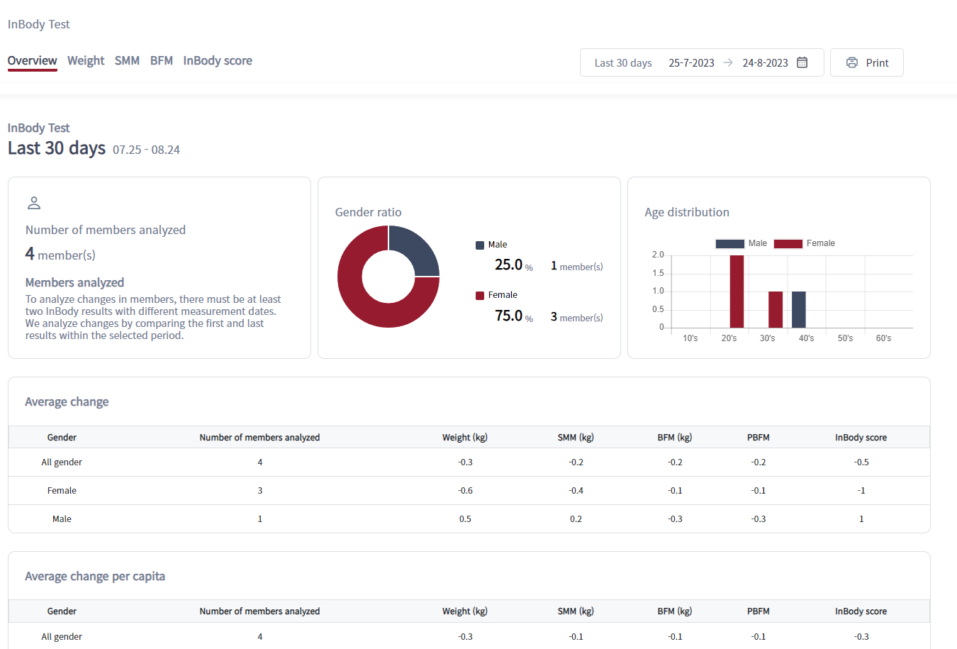

Slide 5
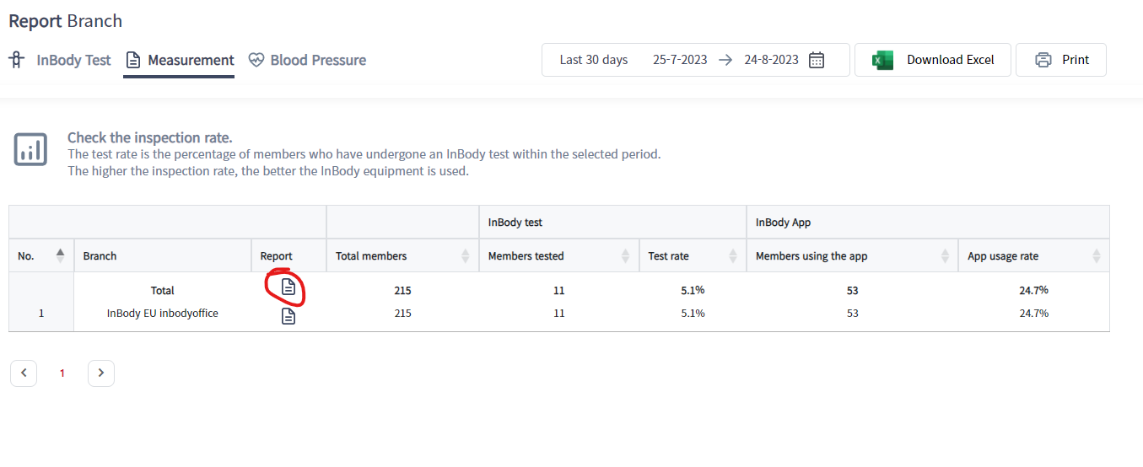

Slide 6
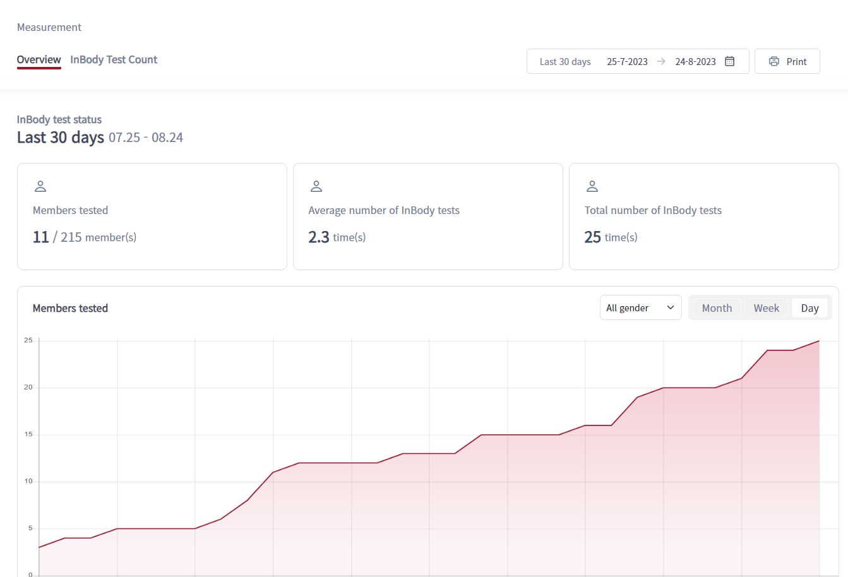

Slide 7
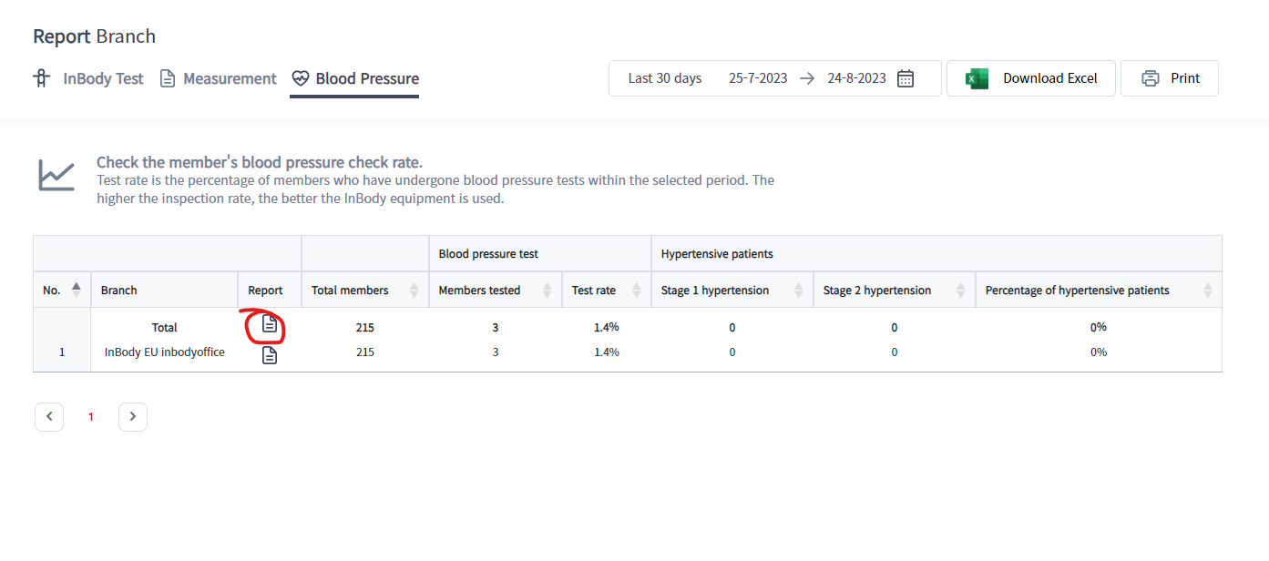

Slide 8
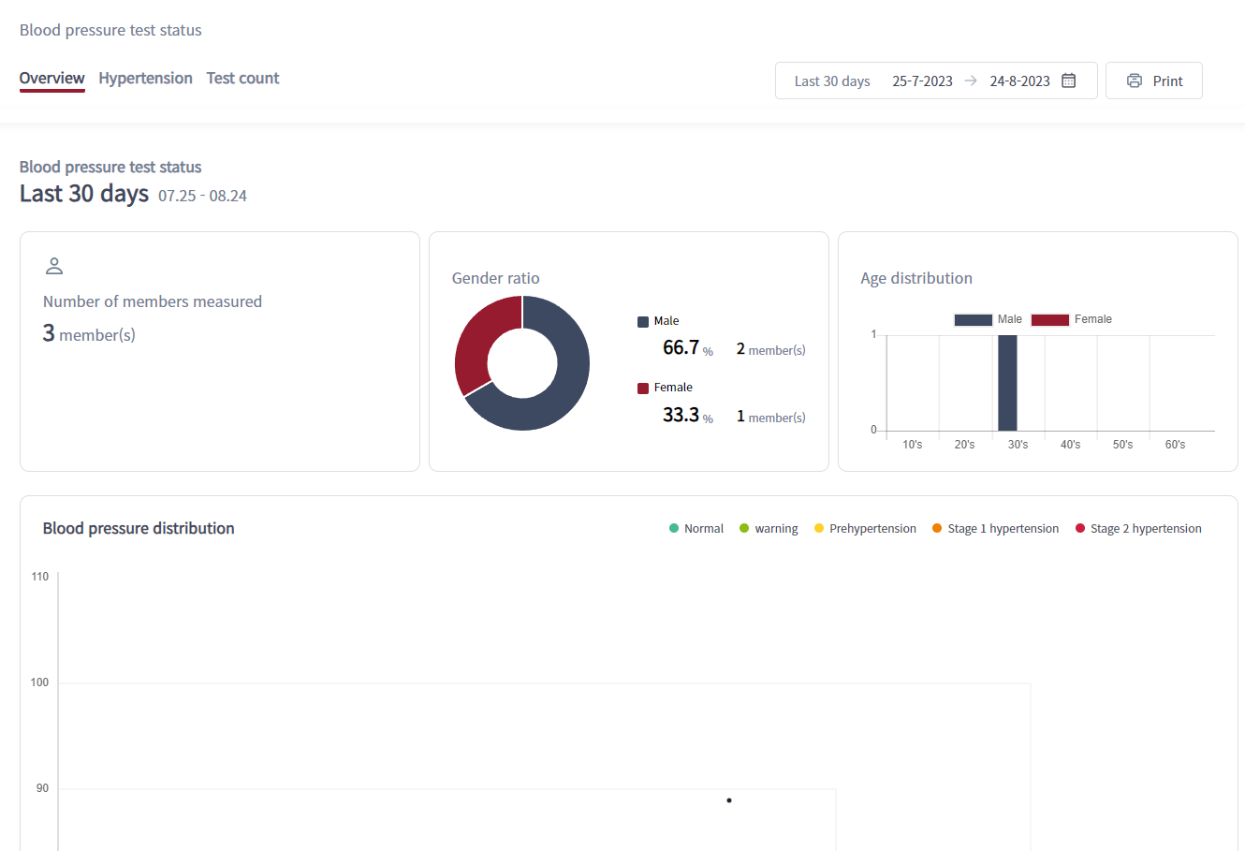

Slide 9
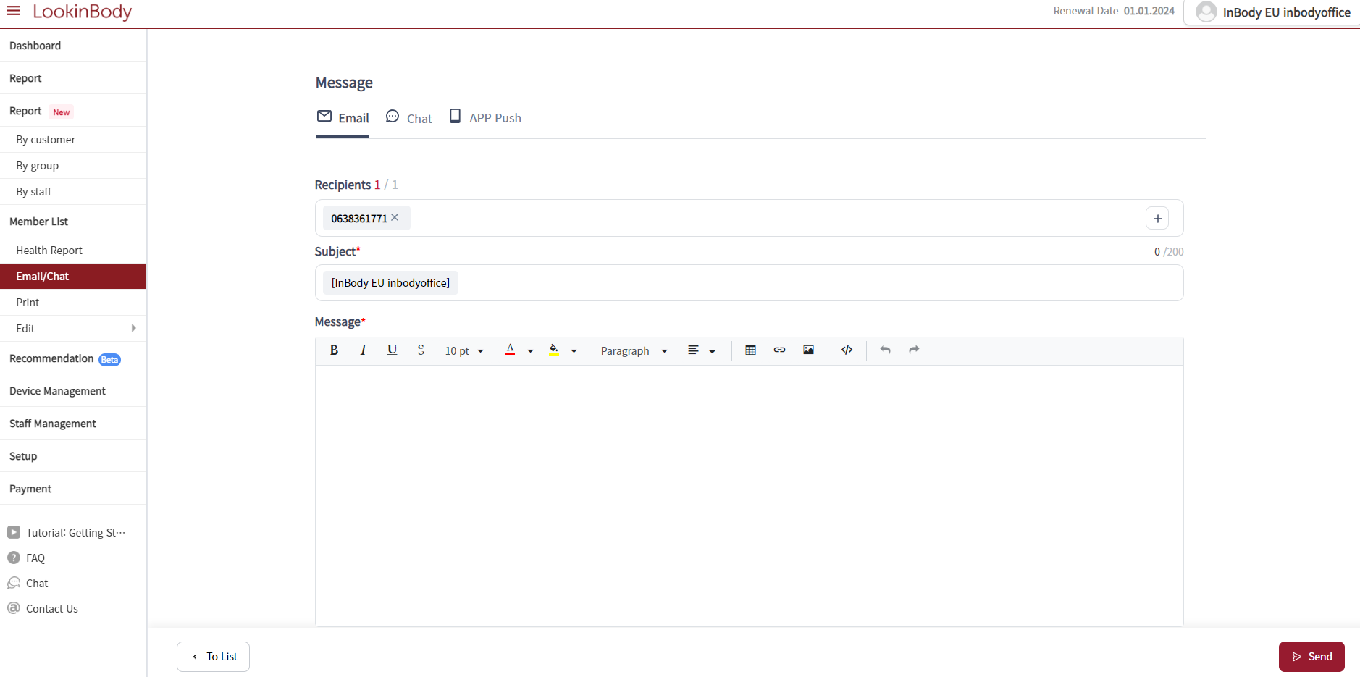
UI for Email and chat is changed. Customer can push chat or alarm to the member’s phone.
Also result paper would not be shared as file. It would send link to download result paper to the user which expires.

Slide 10
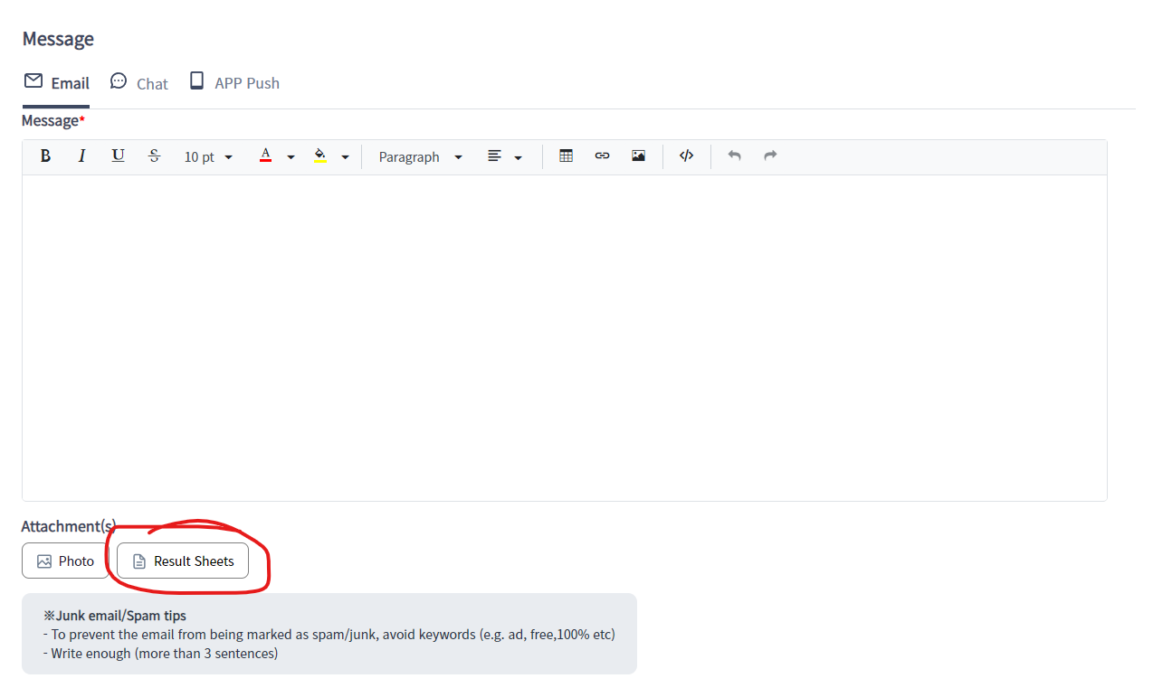
Not the file, separated email containing a link would be shared.

Slide 11
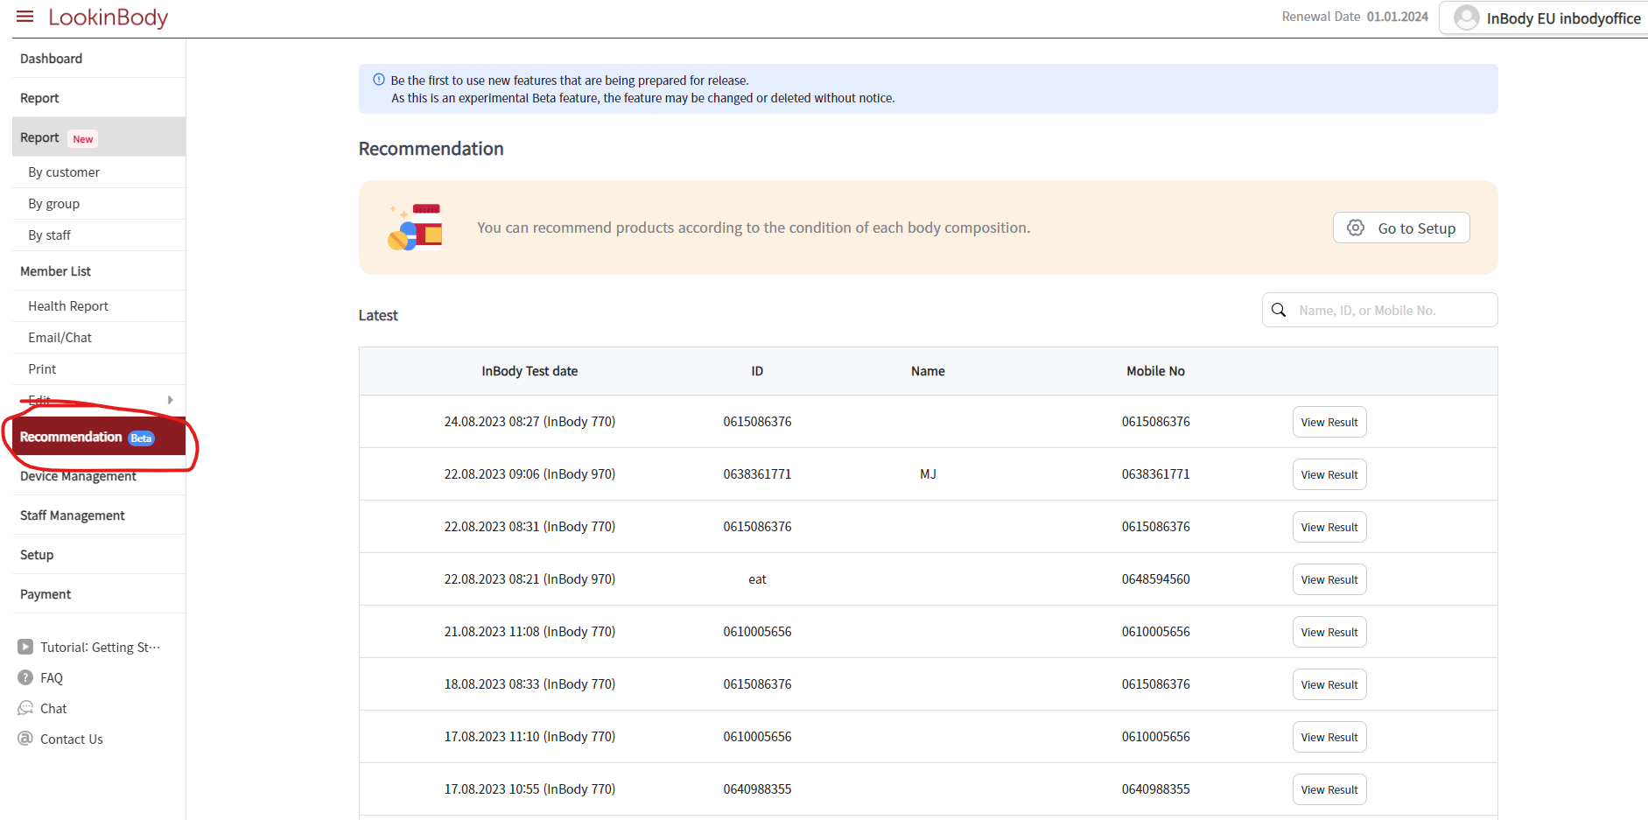
Please check the file which has been shared about the recommendation for the detailed information in the past announcement.

Slide 12
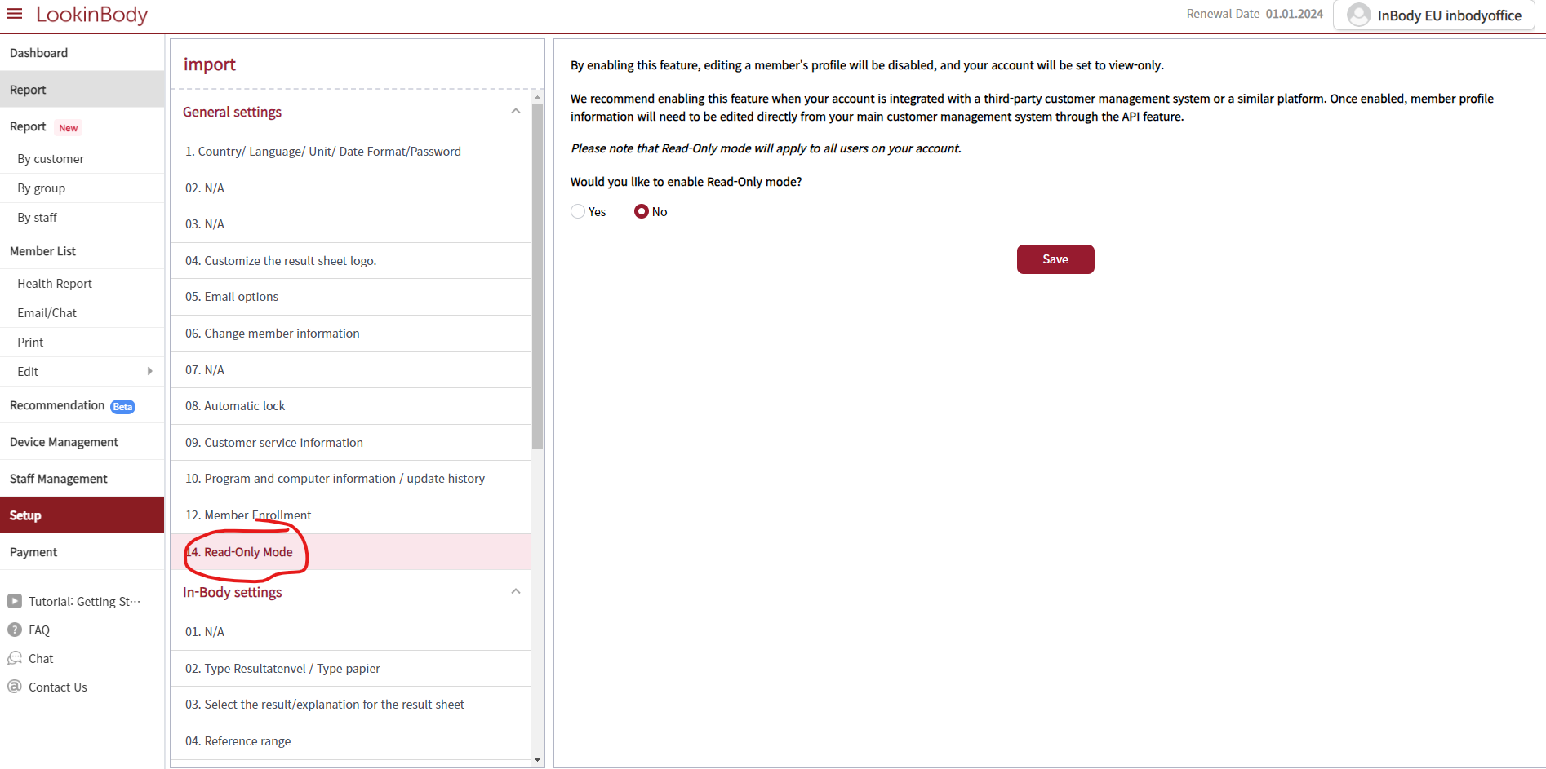
Prevent the manual change of user profile by turning on this setup.

